Slide 1
Python Quiz Competition
Take the Quiz and Find Out!
by GURINDER SINGH
2210990337

Slide 2

Why Python?
• Easy to learn and read (syntax is clear and concise)
• Versatile (used for web development, data science, machine
learning, and more)
• Large and supportive community
• Extensive libraries and frameworks available

Slide 3
How to Play
• The quiz will consist of 15 multiple-choice questions.
• Each question will have 4 answer options.
• You will have a short time limit to answer each question.
• You will receive 5 points for each correct answer and lose 2
points for each wrong answer.
Here's a quick rundown of the game rules. We'll have 15 multiple-choice questions about Python. You'll have a brief moment to choose the answer you think is correct. Each right answer earns you 5 points, while wrong answers deduct 2 points. Remember, a strategic approach is key!

Slide 4
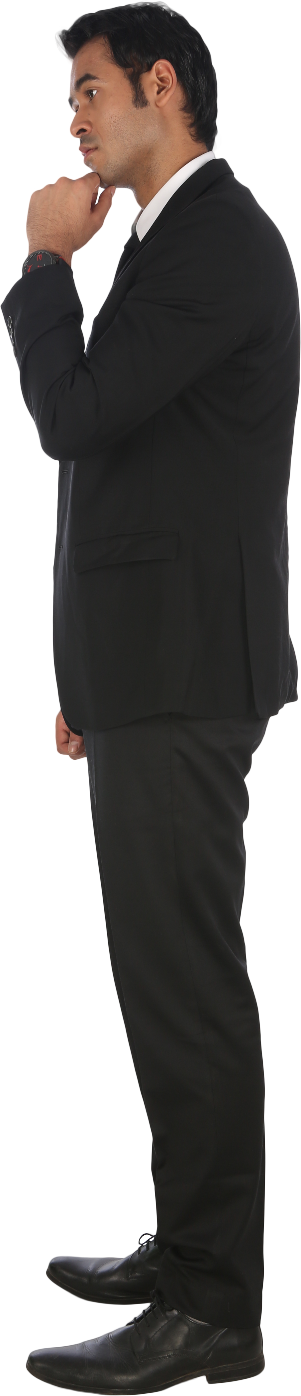

Question # (4-8)
Question 1: What is the capital of France?
Option 1: London
Option 2: Paris
Option 3: Berlin
Option 4: Madrid
Question 2: What is the largest planet in our solar system?
Option 1: Mars
Option 2: Jupiter
Option 3: Venus
Option 4: Earth

Slide 5
Question 3: What is the world's longest river?
Option 1: Nile
Option 2: Amazon
Option 3: Yangtze
Option 4: Mississippi
Question 4: What is the name of the world wide web inventor?
Option 1: Tim Berners-Lee
Option 2: Mark Zuckerberg
Option 3: Bill Gates
Option 4: Larry Page
Question 5: What is the chemical symbol for gold?
Option 1: Au
Option 2: Ag
Option 3: Cu
Option 4: Fe

Slide 6
Question 6: What is the tallest building in the world?
Option 1: Burj Khalifa
Option 2: Shanghai Tower
Option 3: Abraj Al-Bait Clock Tower
Option 4: One World Trade Center
Question 7: What is the largest desert in the world?
Option 1: Sahara
Option 2: Gobi
Option 3: Kalahari
Option 4: Patagonia
Question 8: In which year did World War I begin?
Option 1: 1914
Option 2: 1939
Option 3: 1941
Option 4: 1918

Slide 7
Question 9: What is the capital of Australia?
Option 1: Sydney
Option 2: Melbourne
Option 3: Canberra
Option 4: Perth
Question 10: What is the national animal of India?
Option 1: Tiger
Option 2: Lion
Option 3: Elephant
Option 4: Rhinoceros
Question 11: What is the currency of Japan?
Option 1: Yen
Option 2: Yuan
Option 3: Won
Option 4: Korean Won

Slide 8
Question 12: What mountain range separates Europe and Asia?
Option 1: Alps
Option 2: Himalayas
Option 3: Urals
Option 4: Carpathian
Question 13: What is the largest ocean on Earth?
Option 1: Pacific
Option 2: Atlantic
Option 3: Indian
Option 4: Arctic
Question 14: What is the biggest social media platform?
Option 1: Facebook
Option 2: Instagram
Option 3: Twitter
Option 4: YouTube
Question 15: What is the capital of Brazil?
Option 1: Rio de Janeiro
Option 2: São Paulo
Option 3: Brasília
Option 4: Salvador

Slide 9

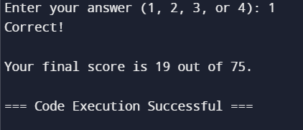
Results!
• Calculate the final score based on the user’s
answers (5 points for correct, -2 points for wrong).
• Display the final score as a big number on the slide.

Slide 10
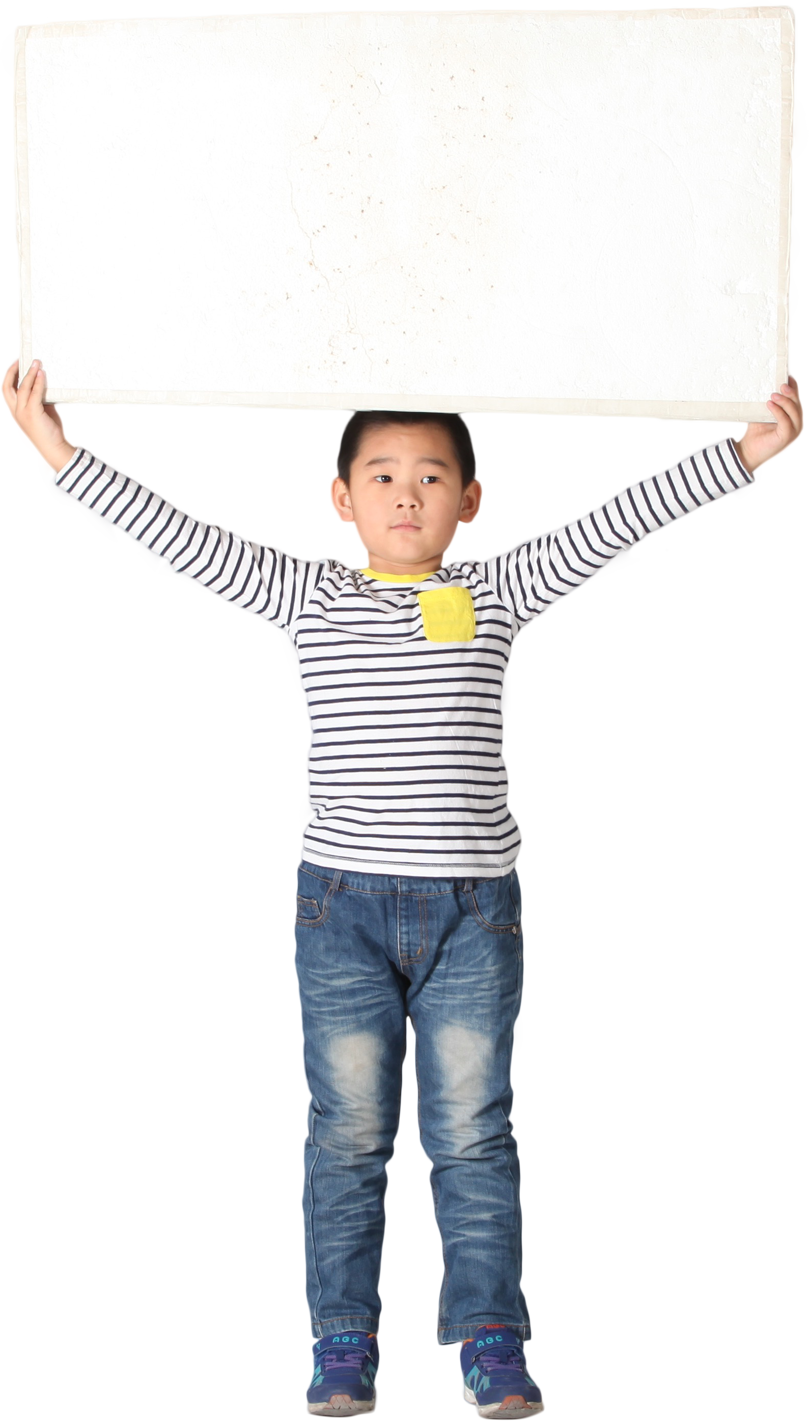
Thank You!

